Slide 1
Open House
Miss Sano’s
5th Grade
2017 - 2018
October 2, 2014
Miss Sano
5th Grade

Slide 2
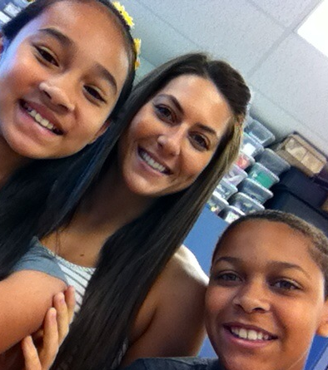
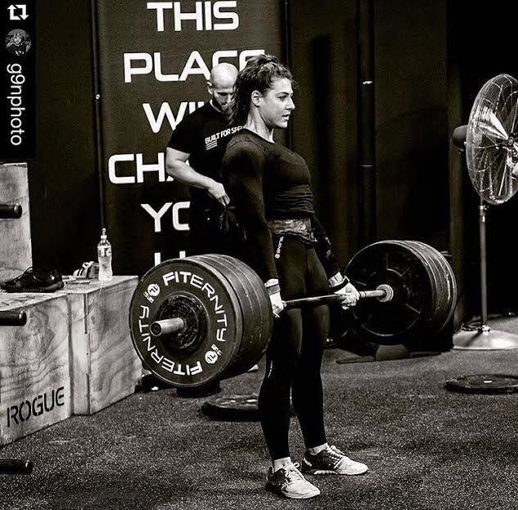
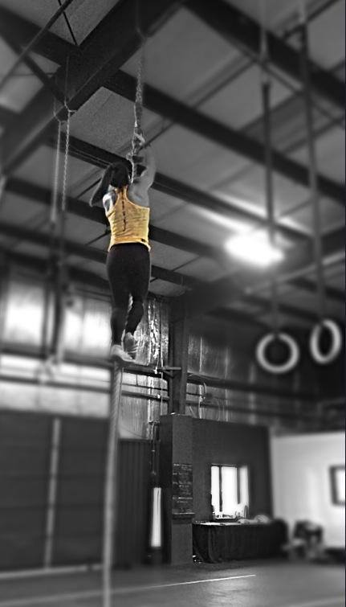
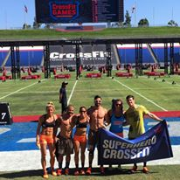
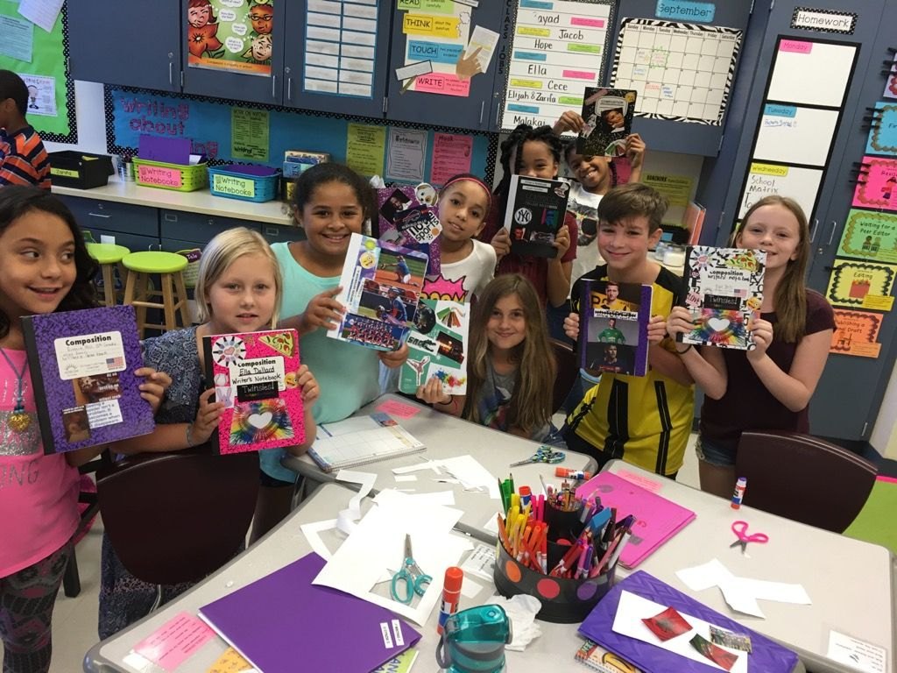
A Little About Me…
Born and raised in Albany, New York
I went to New Scotland Elementary, Hackett Middle School, and Albany High School
I graduated from Oneonta State College with a dual
degree in Early Childhood and Childhood Education
I have a Literacy Specialist Master’s Degree from SUNY Albany
This is my 7th year teaching at Eagle Point Elementary School
I am a mother to a 6 year old Yorkie- Chunk
I compete in Crossfit (weightlifting and gymnastics)
I LOVE TEACHING!

Slide 3
Specials
Monday:
10:25am– 11:05am Art
Tuesday:
9:15am– 9:55am Physical Education
Wednesday:
9:55am– 10:35am Physical Education
Thursday:
9:15am– 9:55am Physical Education
Friday:
8:05am – 8:35am Music
1:30pm – 2:00pm Library

Slide 4
Important Upcoming Dates:
Dad’s Walk Your Child to School Breakfast
September 19th, 7:00am
McDonalds Fundraiser:
“Meet the Teachers” Night
September 26th, 5:00pm-7:00pm
Picture Day
September 28th
No School
September 21st and September 22nd
Literacy Night
October 5th 5:30pm-7:00pm
Book Fair
October 3rd through October 5th
New York State Testing:
English Language Arts:
April 11th – April 13th
Math:
May 1st – May 3rd

Slide 5
Important Information
School hours are from 8:00am - 2:30pm.
Please ensure that your child is on time.
If you child is absent, please send in a note, otherwise it will be marked as an unexcused absence.
You can email me at msano@albany.k12.ny.us or by calling the school.
Visit the 5th/6th website at: http://eagles5th6th.weebly.com/index.html
This site has lots of useful information, including weekly word study and vocabulary words.
Students have a working snack somewhere between 10 and 11. This is a 10 minute working snack, so snacks should be limited to one, quick HEALTHY snack. I stress HEALTHY! Chips, candy, and cookies/cakes don’t give us that great brain food we need.

Slide 6
Homework
Students will have homework each night. LOOK FOR IT!
Each night, Monday through Thursday, they are expected to:
Complete math problem sheet (when provided)
Complete the assigned word study homework and STUDY
Read at least 20 minutes
Get agenda signed by an adult
On Mondays they will have Second Step (Character Education/Health) Homework
One day a week they will have test prep homework- “Tuesday Text”
They should also be reading over the weekend.
(Readers become better readers by reading.)
Students receive raffle tickets every morning for completing their
homework, having their agenda’s signed, and being ready to start the day.
Students who do not have homework completed when the assignment is due will be assigned to stay in from recess to get caught up and risk losing further privileges. I will keep a record of ungraded assignments not completed in a timely manner and will contact parents as necessary.
PLEASE MAKE SURE YOUR CHILD IS DOING THEIR HOMEWORK EACH NIGHT. THIS HELPS TO REINFORCE SKILLS LEARNED IN CLASS.

Slide 7
Grading Policy
Homework: Student Responsibilities
Participation: on task, prepared, showing effort
30%
Formative Assessments: (Progress Assessments) quizzes, exit tickets, in class center work
30%
Summative Assessments: (End of Unit Work) unit tests, projects
40%

Slide 8
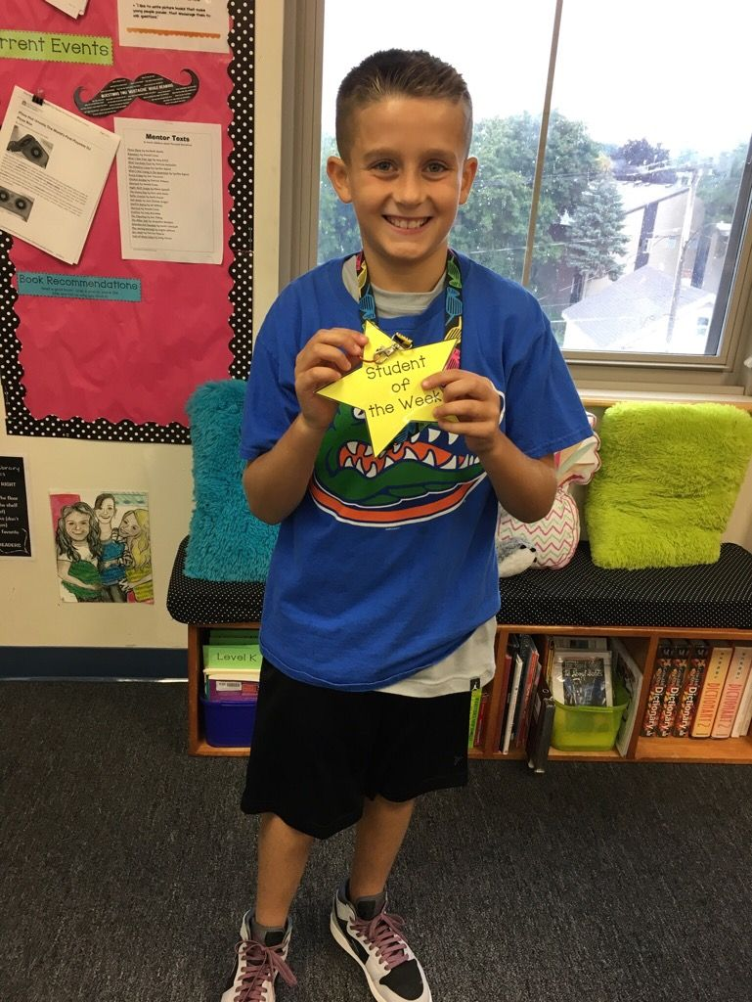
Behavior Management
We are using CLASS DOJO to help students self monitor their behaviors.
Reports will be printed and sent home monthly, if requested.
Parents can monitor this by signing on. If you lost your password, let me know.
As a school, we also participate in PBIS. (Positive Behavioral Intervention Support)
Students with multiple referrals to the office will not be able to participate in a monthly party and will instead receive re-teaching strategies during the party.
Our goals is to have more than 80% participation
in classroom and school rewards!
Families now have a chance to WIN prizes and gift cards!
We have a student of the week assigned each week, for their behavior and achievement.
They will get to wear our college shirt (Florida Gators)
for the day and wear the badge that proudly says “Student of the Week”.

Slide 9
Math
Main Concepts:
Place Value (Base Ten System)
Adding, Subtracting, Multiplying and Dividing Decimals
Adding, Subtracting, Multiplying and Dividing Fractions
Comparing Decimals and Fractions
Common Core has brought us some shifts in math.
Not only are we focusing on fluency, but a deep understanding is expected. Emphasis is on students being able to explain their thinking and how they arrived at their answers.
“Turn and talks” are used as a way for students to explain their thinking and bounce ideas off each other. Using specific math vocabulary is the KEY.
This year we are embracing a new program called EnVisions 2.0
(Includes: kid-friendly pages, online practice, and homework help)

Slide 10
Math Resources
PhotoMath App
Our class website also has a link to helpful math resources (including instructional videos and online practice games)
http://eagles5th6th.weebly.com/math-resources2.html
Download the Smart Phone App:
Pearson Bounce Pages Open the App, place your camera over the play button on the Homework Sheet, and a Reteach Video will pop-up for help!

Slide 11
Math Studio Professional Development
Dates:
Wednesday, Oct. 25th
Thursday, March 29th
Thursday, April 19th
Tuesday, May 22nd
*official schedule is not solidified yet
I will be absent multiple days this year →
Goals of the
Studio Classroom Model:
Promote a high level of student discourse
Justifying answers
Explaining thinking
Leads students to make generalizations
This will allow them to ultimately learn more content/concepts
Enable mathematical access and challenge for ALL students

Slide 12
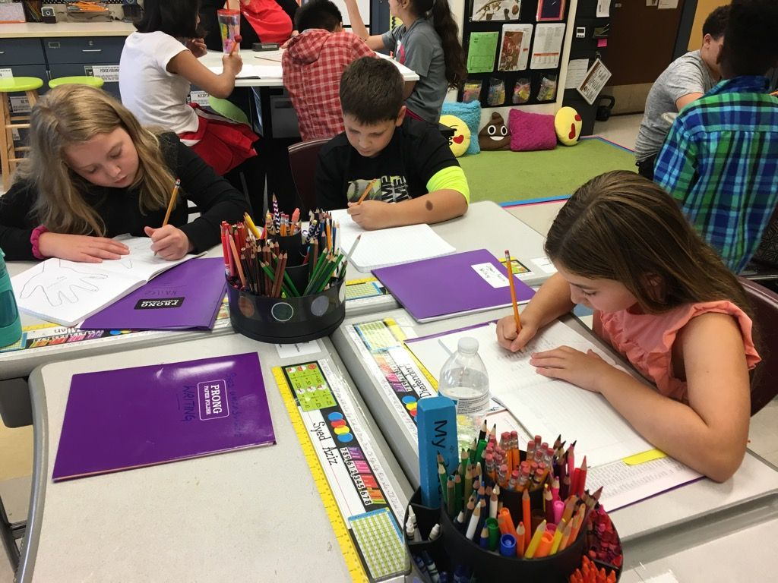
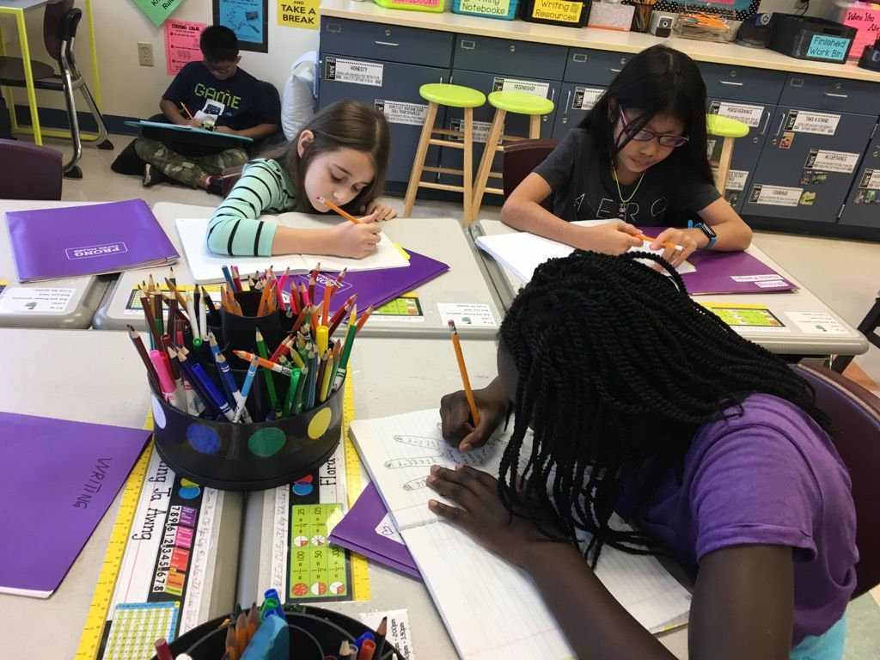
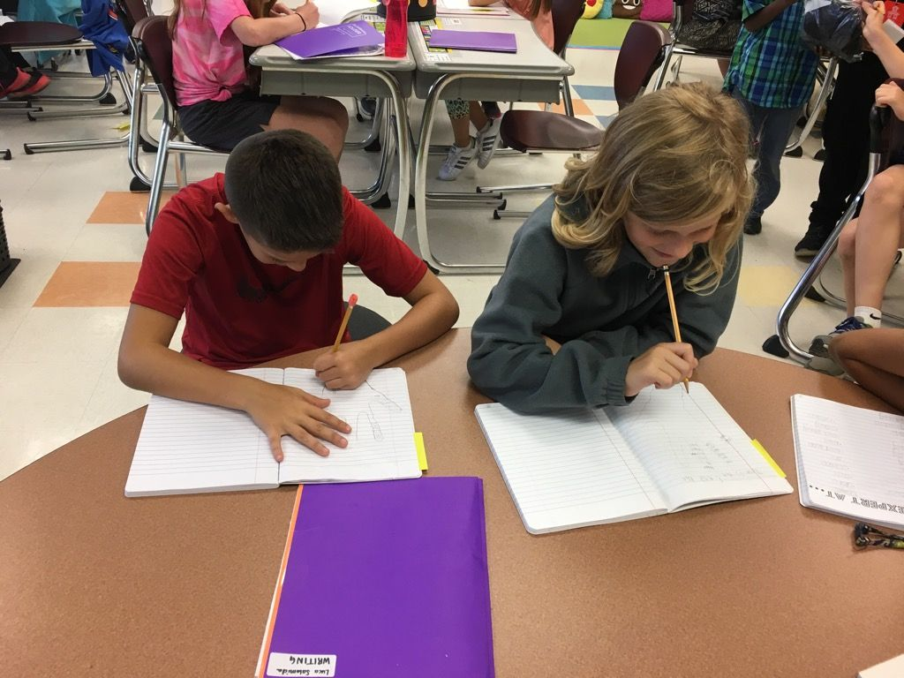
Writing
This year there are many topics of focus, including a persuasive essay, an informational piece, and
a personal narrative.
We are currently working on personal narrative.
Steps in writing include:
Pick a Topic, Moment, or Event
Brainstorm
Drafting
Revising
Editing
Conference
Publish
Celebrate
We will be using our Writer’s Notebooks and a
Writing about Reading Notebook.
Writing 5 paragraph essays with an Introduction, 3 body paragraphs, and a Conclusion will be another skill heavily modeled this year.
(A necessity for future schooling)

Slide 13
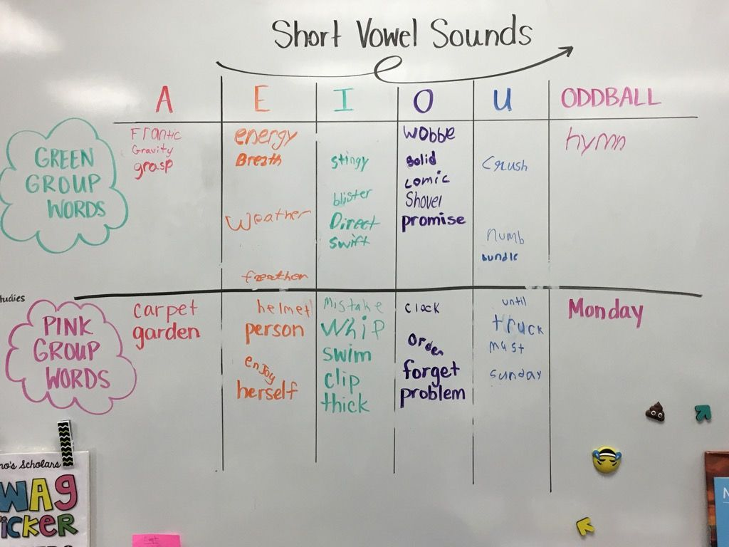
English Language Arts
Our reading daily takes on a few forms. We have daily:
An interactive or shared reading (Read Alouds)
The Daily 3 (Read to Self, Writing about Reading, Partner Reading)
Guided Reading
Word Study
Vocabulary Builders
It is very important that your child is reading at home. Please encourage your child to read many genres.
Books read independently at home should be at their level and “just right”.
Read-alouds are still a great way to share reading with your child and model fluency.
We will have a reading binder this year, where students have a poetry section, Informational and Literature Text section, and a reading log, along with many anchor charts to aid them while reading. By the end of the year, they will have a binder full of texts and reading strategies to read and use over the summer!

Slide 14
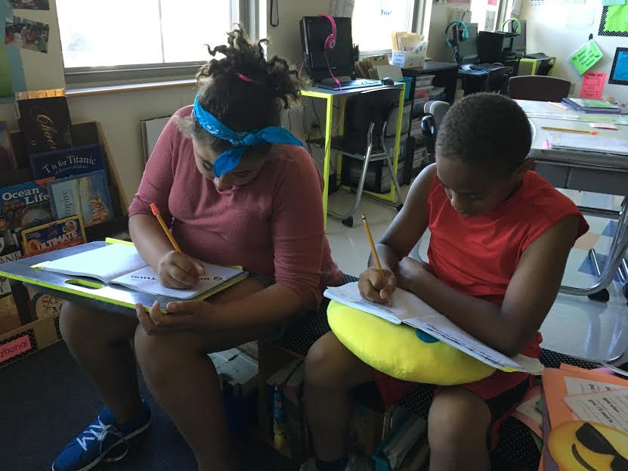
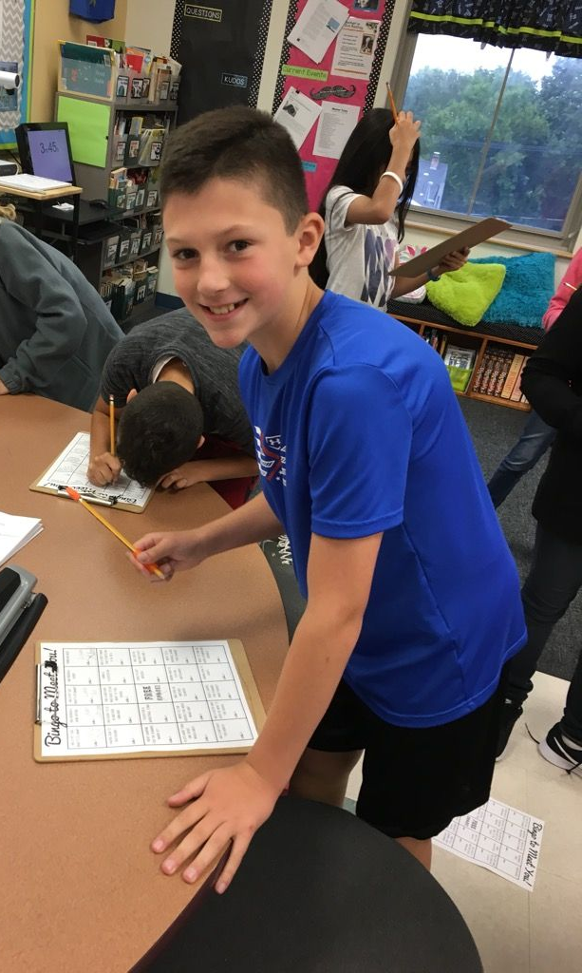
Social Studies
Main Concept: United States History
To view the entire 5th grade Social Studies curriculum map, visit the district website at: http://www.albanyschools.org/Academics/socialstudies/Grade5.pdf
We are currently working on U.S. Regions, geography, and map skills.
Some other areas of focus are:
The Colonial Period
The American Revolution
Slavery and The Civil War
Immigration
The Industrial Revolution
Modern America
The students are currently creating Glogs on a chosen land region and state. When the projects are finished, they can be accessed on-line.
As the saying goes:
“Tell me, I forget. Show me, I remember. Involve me, I understand.”

Slide 15
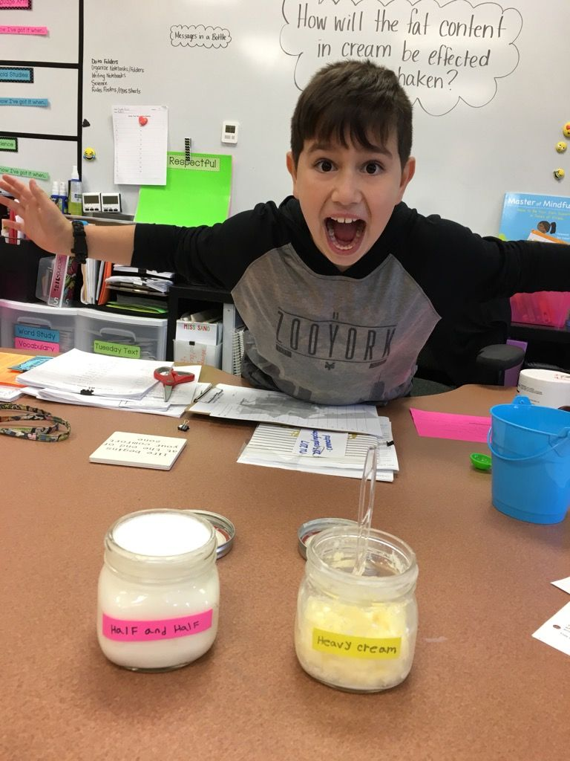
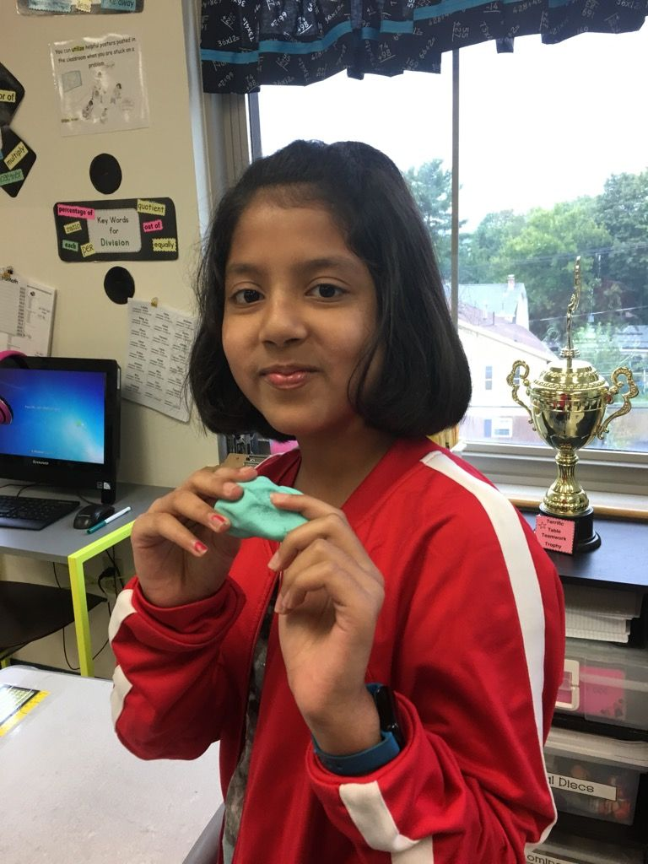
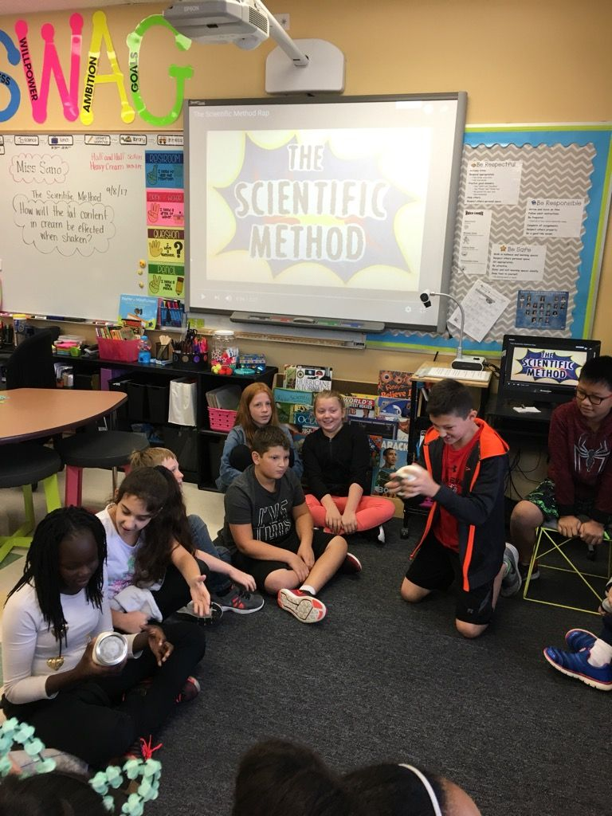
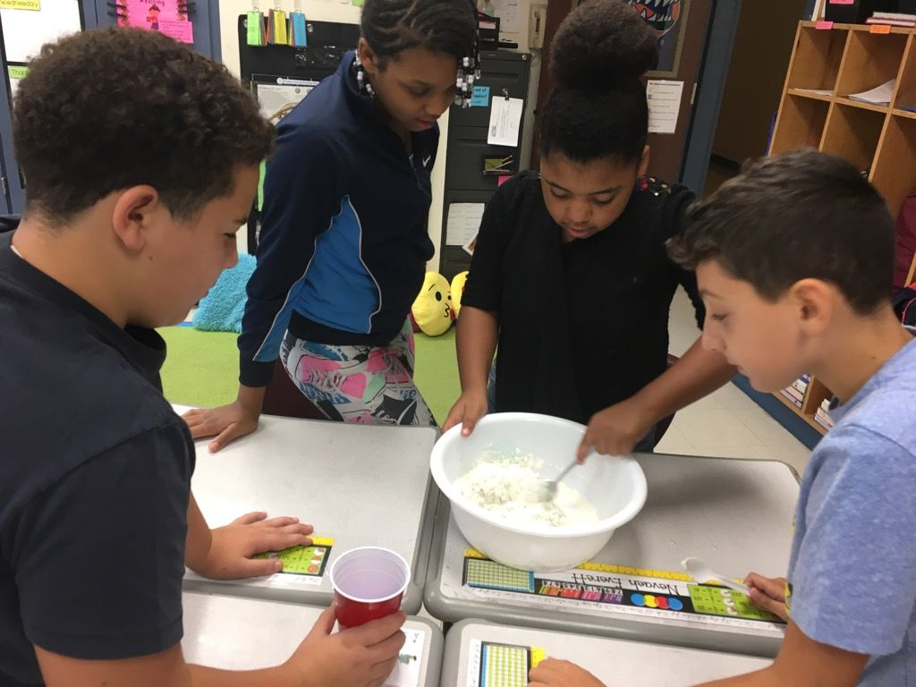
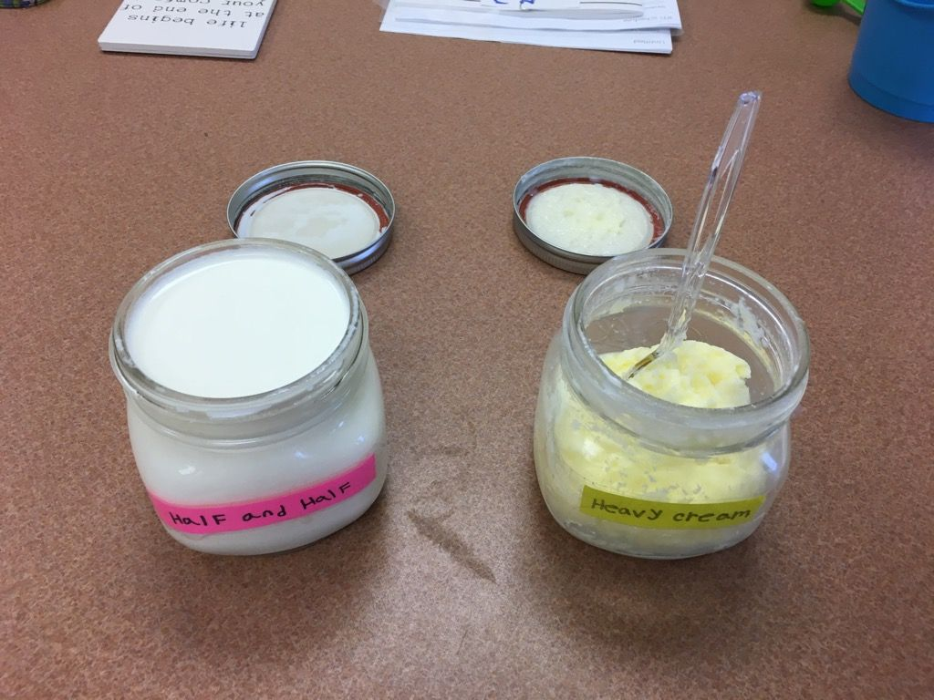
Science
Main Concept: The Scientific Method
We are currently beginning our unit on plants and animal cells.
Some other areas of focus are:
The Human Body
Energy and Motion
Matter/Properties
The Solar System
To view the entire 5th grade Science curriculum map, visit the district website at: http://www.albanyschools.org/Academics/Science/PDFs/Science-Grade%205%20pacing%20map%209-07.pdf
We do a Hands-On Experiment every Friday.
We focus on the Scientific Method in preparation for
the Science Fair in Spring.

Slide 16
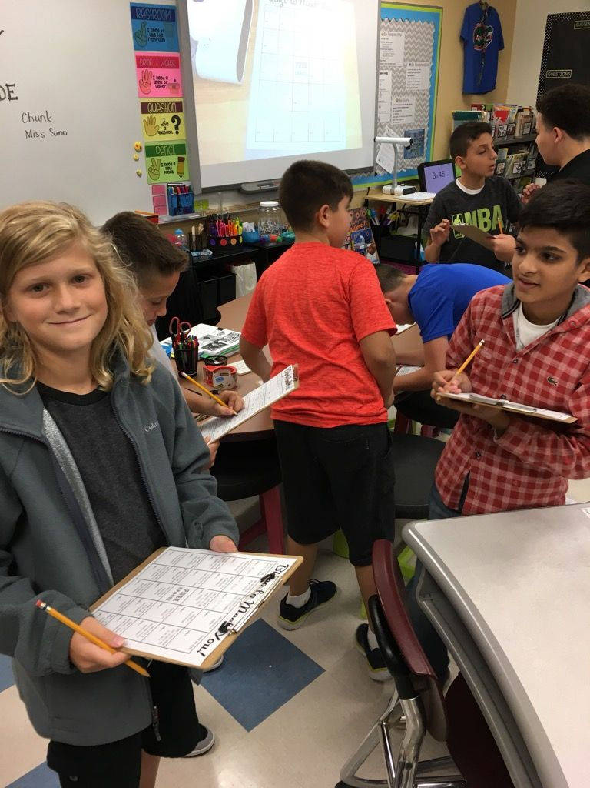
How can I help my child be successful?
Check daily for homework and sign the homework agenda.
2. Make sure they are reading for 20 minutes daily.
3. Check any letters, notes, or Class Dojo information that comes home.
4. Check out the 5th grade website. http://eagles5th6th.weebly.com/miss-sano.html
5. Visit: www.kidsites.com for great sites for kids!
6. Contact me ANY time you have any questions or
concerns. WE ARE A TEAM!!

